Slide 1
Block Chaser (Game)
Embedded Hardware/Software Project
By Janssen Gamilla
ECE 4225 - Hardware/Software Co-Design

Slide 2
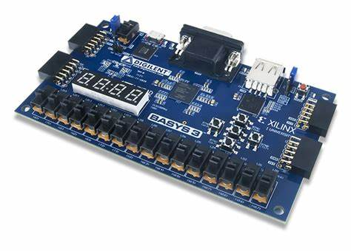
Objective
Design a project that implements a combined Hardware/Software Embedded system.
ECE 4225

Slide 3
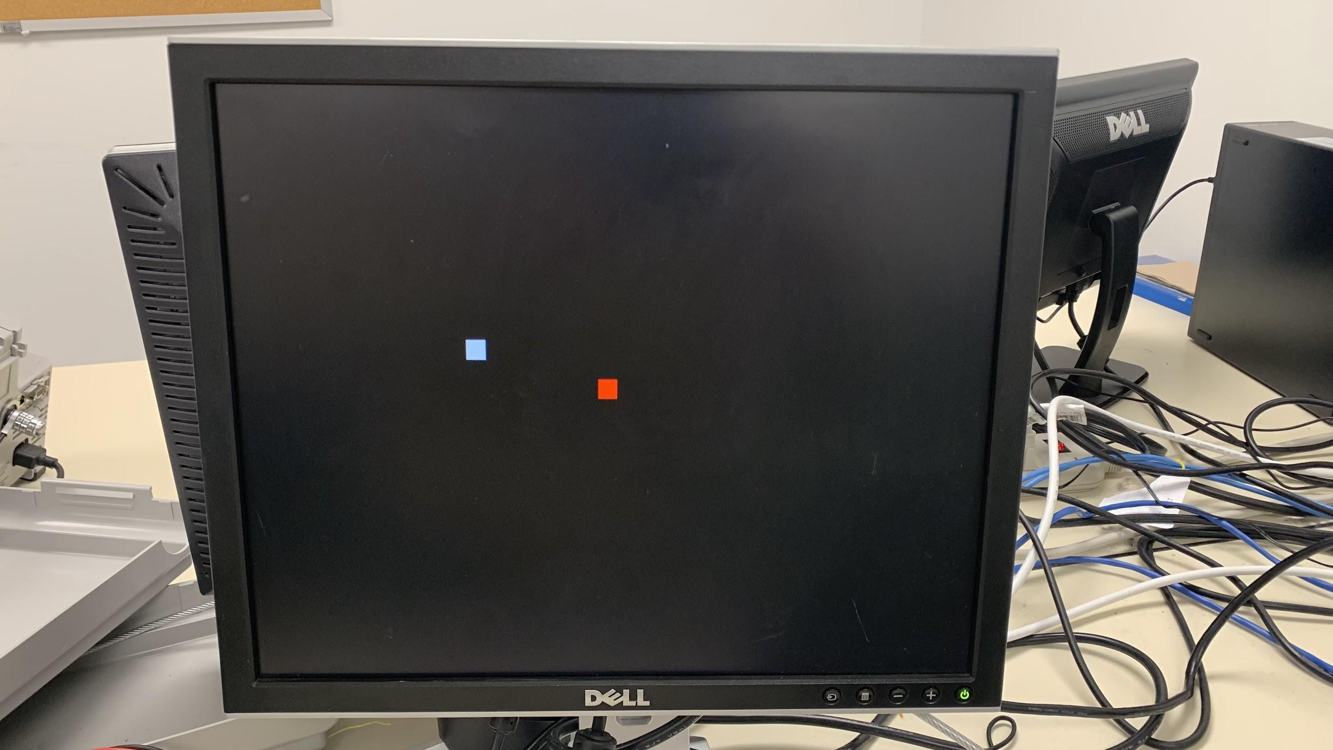
Block Chasing Game
Design
User directs the movement of their block
If a target block is reached, the user’s block changes color, score incremented
When score limit is reached, game restarts
Inputs
4 Push buttons on the Basys 3 FPGA Development board
Outputs
VGA Monitor (640x480 @ 60Hz)
ECE 4225

Slide 4

Basic Functional Decomposition
Hardware
Handling User input
Button presses
Outputting VGA Graphics
Output RGB values
Drive Hsync and Vsync
Software
Game Logic
Starting and restarting game
User block movement/direction
User and target positions
Detecting Collision
Changing user block color
ECE 4225

Slide 5
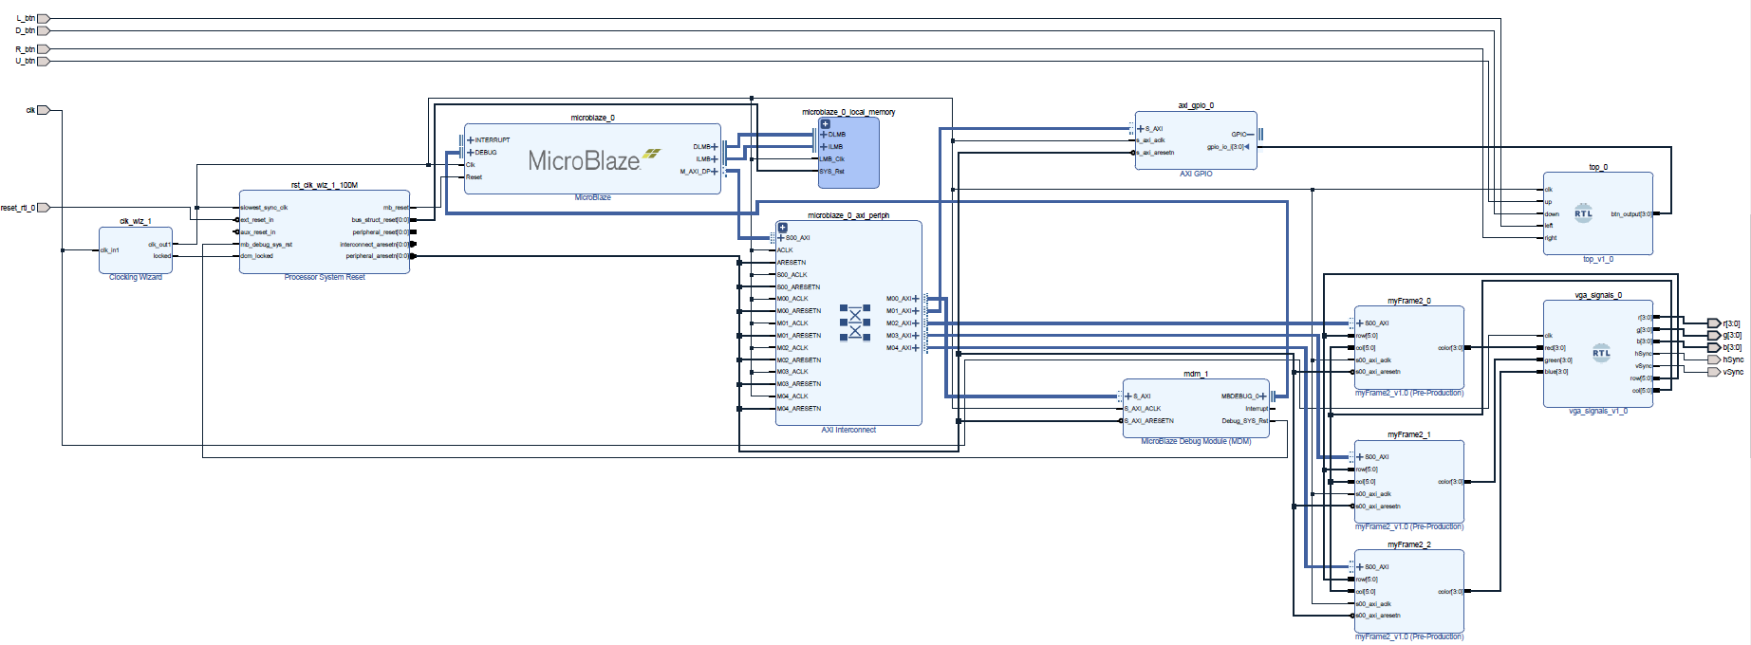
Block Diagram
ECE 4225

Slide 6
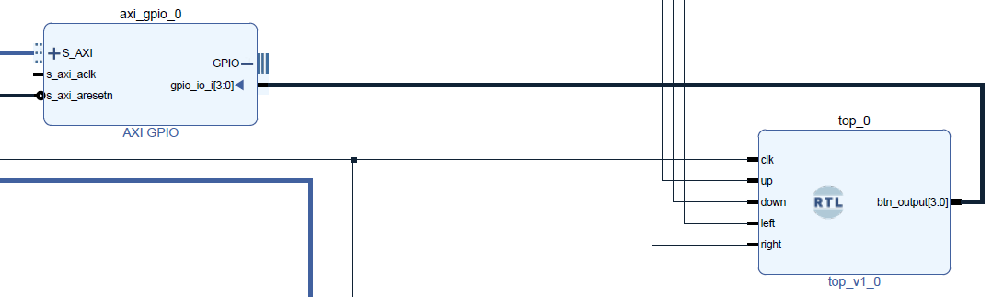
Hardware Modules
User Input Handling
4 Push Buttons
Each drive a single bit in a 4 bit vector
Ex: Up button drives an output of “0001”, down button drives “0010”
Vector connected to an AXI GPIO core block
Easy interfacing with AXI Bus
Able to be read in software (with the help of some libraries)
ECE 4225

Slide 7
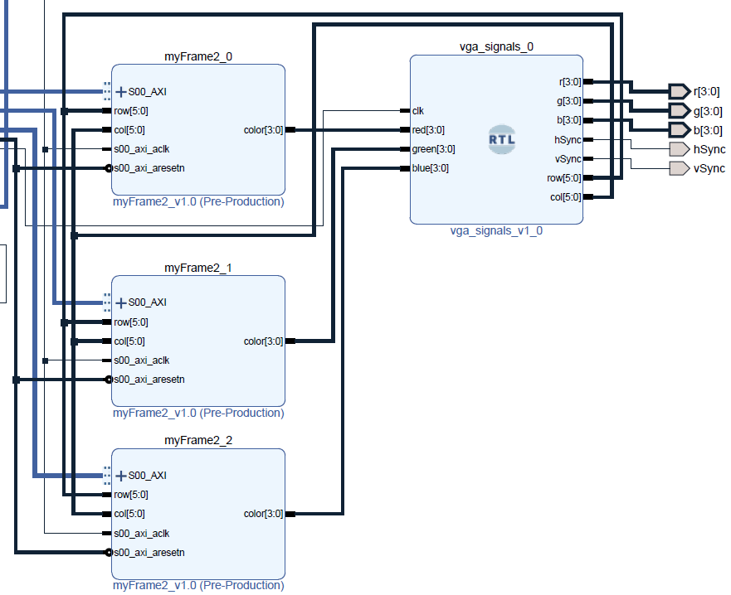
Hardware Modules
VGA Output
Frame buffer
Contain 4-bit color value to row/col pairs
VGA Signal Module
Mapped to Basys 3 VGA pins for output to monitor
Handle HSync and VSync
ECE 4225

Slide 8
VGA Drawing Design
What’s drawn to the registers
12-bit RGB value for red
(F,0,0)
Divided 640x480 screen
300 registers for each frame buffer
4 blocks for each register
Writing to registers
Each register is a different location
Assign a value to each location
Able to get colors on screen
Red: 0x0000000F
Green: 0x00000000
Blue: 0x00000000
Red: 0x00000000
Green: 0x000000F0
Blue: 0x00000000
ECE 4225
Notes:
40 rows, 30 columns (1,200 total indices)
16-bit blocks divided into 4 squares
1,200/4 = 300 registers

Slide 9
Main Software Components
moveDirection(int readData)
Changes direction of the user’s block based on button press (readData)
Up button sets yDirection =1 and xDirection = 0
y+= yDirection; x+=xDirection;
Calls draw_pixel(int x, int y)
changeColor()
Changes color of user block
Utilizes most significant 16 bits unused for each color frame
Ex: userRed = 0x0001FFFF, next color is blue, so userRed = 0x00100000
Bit masking used to determine color
startGame()
Initializes game
Calls gameWon() to determine whether to restart game
detectCollision()
Compares user block x and y values to target’s position to determine collision
Set new target position if collided
ECE 4225

Slide 10

Issues Faced
No monitor output
Hsync and Vsync not properly counted
VGA Controller
Had to restrict bounds of play
Portions of screen duplicated
Graphic updating method
Results in observable screen blinking
Originally tried to implement the Snake game
Image source
ECE 4225

Slide 11
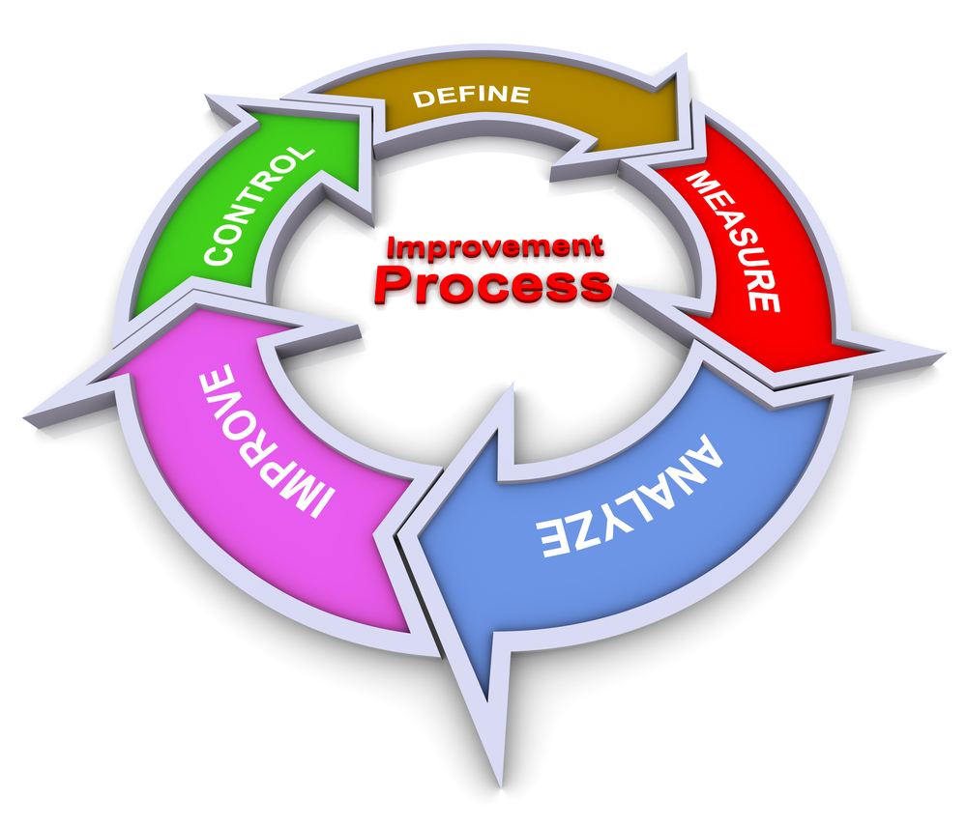
Future Improvements
Fixing Screen Duplication
Utilize entire screen for game
Game reset functionality
Software organization
Displaying Score
Adding difficulty levels
Obstacles
Image source
ECE 4225

Slide 12

Project Demo
ECE 4225

Slide 13
Thank You
Questions?
ECE 4225

